Slide 1
Input-Output Subsystem

Slide 2
The input-output subsystem of a computer, referred to as I/O which provides an efficient mode of communication between the central system and the outside environment.
Programs and data must be entered into computer memory for processing and results obtained from computations must be recorded or displayed for the user.
Input or output devices attached to the computer are also called peripherals.
The most common peripherals are keyboards, display units, and printers. Peripherals that provide auxiliary storage for the system are magnetic disks and tapes. Peripherals are electromechanical and electromagnetic devices of some complexity.
The most familiar means of entering information into a computer is a keyboard that allows a person to enter alphanumeric information directly. Every time a key is depressed, the terminal sends a binary coded character to the computer. The fastest possible speed for entering Information this way depends on the person's typing speed.

Slide 3
There are different types of video monitors, but the most popular use a cathode ray tube (CRT). The CRT contains an electronic gun that sends an electronic beam to a phosphorescent screen in front of the tube.
Printers provide a permanent record on paper of computer output data or text. There are three basic types of character printers, 1. Daisywheel 2. Dot matrix 3. Laser printers
Magnetic tapes are used mostly for storing files of data: for example, a company's payroll record. Access is sequential and consists of records that can be accessed one after another as the tape moves along a stationary read-write mechanism. It is one of the cheapest and slowest methods for storage and has the advantage that tapes can be removed when not in use.
Magnetic disks have high-speed rotational surfaces coated with magnetic material. Access is achieved by moving a read-write mechanism to a track in the magnetized surface. Disks are used mostly for bulk storage of programs and data

Slide 4
Input-Output Device Interface
Input-output device interface provides a method for transferring information between internal storage and external I/O devices.
Peripherals connected to a computer need special communication links for interfacing them with the central processing unit.
Fig: Connection of I/O bus to input-output devices

Slide 5
There are four types of commands that an interface may receive. They are classified as
1.Control command.
2. Status command
3. Data output command
4. Data input command
A control command is issued to activate the peripheral and to inform it what to do. For example, a magnetic tape unit may be instructed to backspace the tape by one record, to rewind the tape, or to start the tape moving in the forward direction. The particular control command issued depends on the peripheral.
A status command is used to test various status conditions in the interface and the peripheral. For example, the computer may wish to check the status of the peripheral before a transfer is initiated. During the transfer, one or more errors may occur which are detected by the interface. These errors are designated by setting bits in a status register that the processor can read at certain intervals.
A data output command causes the interface to respond by transferring data from the bus into one of its registers. Consider an example with a tape unit. The computer starts the tape moving by issuing a control command. The processor then monitors the status of the tape by means of a status command. When the tape is in the correct position, the processor issues a data output command. The interface responds to the address command and transfers the information from the data lines in the bus to its buffer register. The interface then communicates with the tape controller and sends the data to be stored on tape.
The data input command is the opposite of the data output. In this case the interface receives an item of data from the peripheral and places it in its buffer register. The processor checks if data are available by means of a status command and then issues a data input command. The interface places the data on the data lines, where they are accepted by the processor.

Slide 6
Modes of Transfer or I/O Transfers
Binary information received from an external device is usually stored in memory for later processing.
Data transfer between the central computer and I/O devices may be handled in different modes.
Data transfer to and from peripherals may be handled in one of three possible modes:
1. Programmed I/O
2. Interrupt-initiated I/O/Interrupt Driven I/O
3. Direct memory access (DMA)

Slide 7
Programmed I/O
Programmed I/O operations are the result of I/O instructions written in the computer program. Each data item transfer is initiated by an instruction in the program.
Transferring data under program control requires constant monitoring of the peripheral by the CPU.
Once a data transfer is initiated, the CPU is required to monitor the interface to see when a transfer can again be made. It is up to the programmed instructions executed in the CPU to keep close tabs on everything that is taking place in the interface unit and the I/O device.

Slide 8
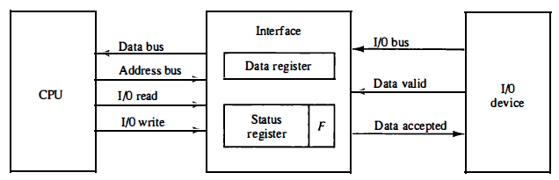
Fig: Data transfer from an I/O device to CPU

Slide 9
Transfer of data requires three instructions
1) Read the Status register.
2)Check the status of the flag bit and branch to step1,if not set or to step 3 if set.
3) Read the data register.

Slide 10
Operation of I/O
CPU requests I/O operation
I/O module performs operations
I/O module sets status bits
CPU checks status bits periodically.
I/O module does not inform cpu directly.
I/O module does not interrupt cpu.
CPU may wait or comeback later.
Under programmed I/O data transfer is very like memory access.
Each device is given an unique identifier.
CPU commands contain identifier(address)

Slide 11
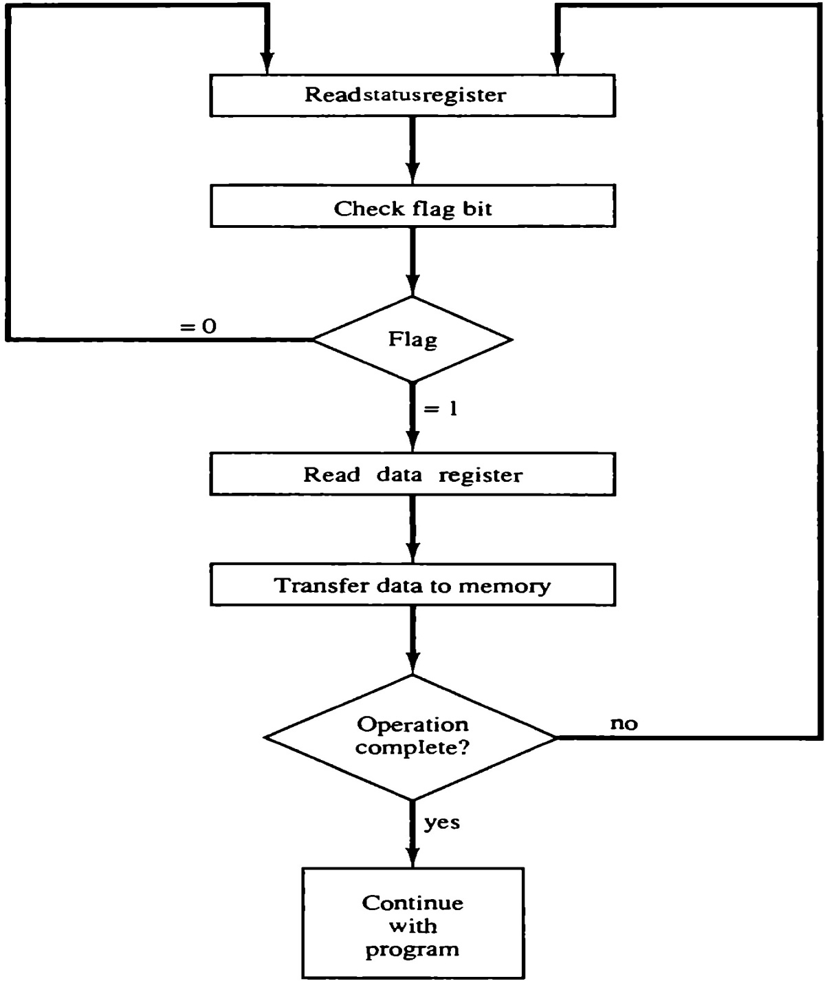
Fig: Flowchart for CPU program to input data

Slide 12
Advantages:
Programmed I/O is simple to implement.
It requires very little hardware support.
CPU checks status bits periodically.
Disadvantages:
The processor has to wait for a long time for the I/O module to be ready for either transmission or reception of data.
The performance of the entire system is severely degraded.

Slide 13
Interrupt-Initiated I/O/Interrupt Driven I/O
Better than programmed I/O
but too many interrupts occur
for every byte of input and output.
Processing an interrupt is expensive.
Working:
CPU issues read command
I/O module gets data from peripherals while cpu does other work
I/O module interrupts CPU
CPU requests data
I/O module transfer data.

Slide 14
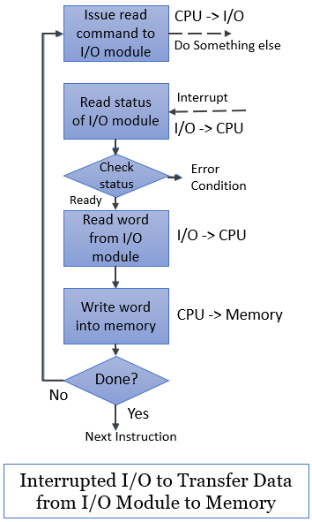

Slide 15
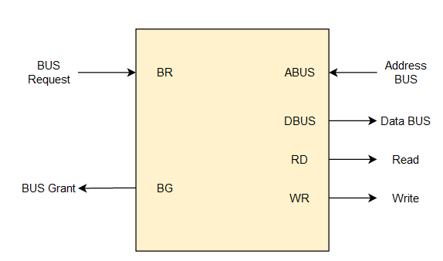
DMA(Direct Memory Access)
The data transfer between a fast storage media such as magnetic disk and memory unit is limited by the speed of the CPU. Thus we can allow the peripherals directly communicate with each other using the memory buses, removing the intervention of the CPU. This type of data transfer technique is known as DMA or direct memory access.
DMA the CPU is idle and it has no control over the memory buses. The DMA controller takes over the buses to manage the transfer directly between the I/O devices and the memory unit.
CPU Bus Signal for DMA transfer

Slide 16
Direct memory access (DMA) is a mode of data transfer between the memory and I/O devices. This happens without the involvement of the processor.
Bus Request - We use bus requests in the DMA controller to ask the CPU to relinquish the control buses.
Bus Grant - CPU activates bus grant to inform the DMA controller that DMA can take control of the control buses. Once the control is taken, it can transfer data in many ways.
Types of DMA transfer using DMA controller:
Burst Transfer: In this transfer, DMA will return the bus control after the complete data transfer. A register is used as a byte count, which decrements for every byte transfer, and once it becomes zero, the DMA Controller will release the control bus. When the DMA Controller operates in burst mode, the CPU is halted for the duration of the data transfer.
Cyclic Stealing: It is an alternative method for data transfer in which the DMA controller will transfer one word at a time. After that, it will return the control of the buses to the CPU. The CPU operation is only delayed for one memory cycle to allow the data transfer to “steal” one memory cycle.

Slide 17
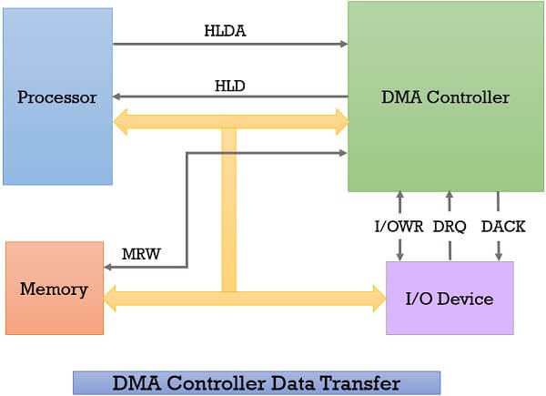
DMA controller is a hardware unit that allows I/O devices to access memory directly without the participation of the processor. DMA controller is a control unit, part of I/O device’s interface circuit, which can transfer blocks of data between I/O devices and main memory with minimal intervention from the processor.

Slide 18
Whenever an I/O device wants to transfer the data to or from memory, it sends the DMA request (DRQ) to the DMA controller. DMA controller accepts this DRQ and asks the CPU to hold for a few clock cycles by sending it the Hold request (HLD).
CPU receives the Hold request (HLD) from DMA controller and relinquishes the bus and sends the Hold acknowledgement (HLDA) to DMA controller.
After receiving the Hold acknowledgement (HLDA), DMA controller acknowledges I/O device (DACK) that the data transfer can be performed and DMA controller takes the charge of the system bus and transfers the data to or from memory.
When the data transfer is accomplished, the DMA raise an interrupt to let know the processor that the task of data transfer is finished and the processor can take control over the bus again and start processing where it has left.

Slide 19
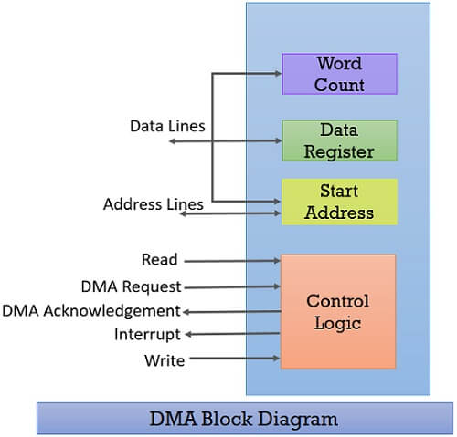
Direct Memory Access Diagram
After exploring the working of DMA controller, let us discuss the block diagram of the DMA controller. Below we have a block diagram of DMA controller.

Slide 20
The first information is whether the data has to be read from memory or the data has to be written to the memory. It passes this information via read or write control lines that is between the processor and DMA controllers control logic unit.
The processor also provides the starting address of/ for the data block in the memory, from where the data block in memory has to be read or where the data block has to be written in memory. DMA controller stores this in its address register. It is also called the starting address register.
The processor also sends the word count, i.e. how many words are to be read or written. It stores this information in the data count or the word count register.
The most important is the address of I/O device that wants to read or write data. This information is stored in the data register.
Direct Memory Access Advantages and Disadvantages
Advantages:
Transferring the data without the involvement of the processor will speed up the read-write task.
DMA reduces the clock cycle requires to read or write a block of data.
Implementing DMA also reduces the overhead of the processor.
Disadvantages:
As it is a hardware unit, it would cost to implement a DMA controller in the system.
Cache coherence problem can occur while using DMA controller.

Slide 21
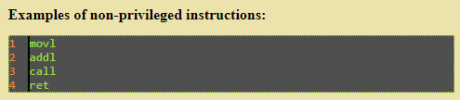
privileged and non-privileged instructions
Non-privileged instructions: Non-privileged instruction is an instruction that any applications or user can execute.
Various examples of Non-Privileged Instructions include:
Reading the status of Processor
Reading the System Time
Generate any Trap Instruction
Sending the final printout of Printer

Slide 22
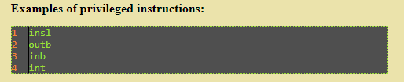
privileged instructions: privileged instruction is an instruction that can only be executed in kernel mode. Instructions are divided in this manner because privileged instructions could harm the kernel.
Privileged characteristics:
(i) If any attempt is made to execute a Privileged Instruction in User Mode, then it will not be executed and treated as an illegal instruction. The Hardware traps it in the Operating System.
(ii) Before transferring the control to any User Program, it is the responsibility of the Operating System to ensure that the Timer is set to interrupt. Thus, if the timer interrupts then the Operating System regains control.
Thus, any instruction which can modify the contents of the Timer is Privileged Instruction.
(iii) Privileged Instructions are used by the Operating System in order to achieve correct operation.

Slide 23
(iv) Various examples of Privileged Instructions include:
I/O instructions and Halt instructions
Turn off all Interrupts
Set the Timer
Context Switching
Clear the Memory or Remove a process from the Memory
Modify entries in the Device-status table

Slide 24
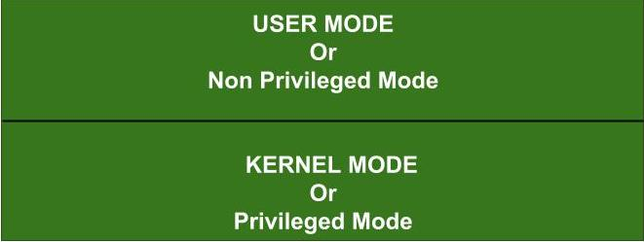

Slide 25
Differences between privileged and non-privileged instructions
Access to resources: Privileged instructions have direct access to system resources, while non-privileged instructions have limited access.
Execution mode: Privileged instructions are executed in kernel mode, while non-privileged instructions are executed in user mode.
Execution permissions: Privileged instructions require special permissions to execute, while non-privileged instructions do not.
Purpose: Privileged instructions are typically used for performing low-level system operations, while non-privileged instructions are used for general-purpose computing.
Risks: Because privileged instructions have access to system resources, they pose a higher risk of causing system crashes or security vulnerabilities if not used carefully. Non-privileged instructions are less risky in this regard.

Slide 26
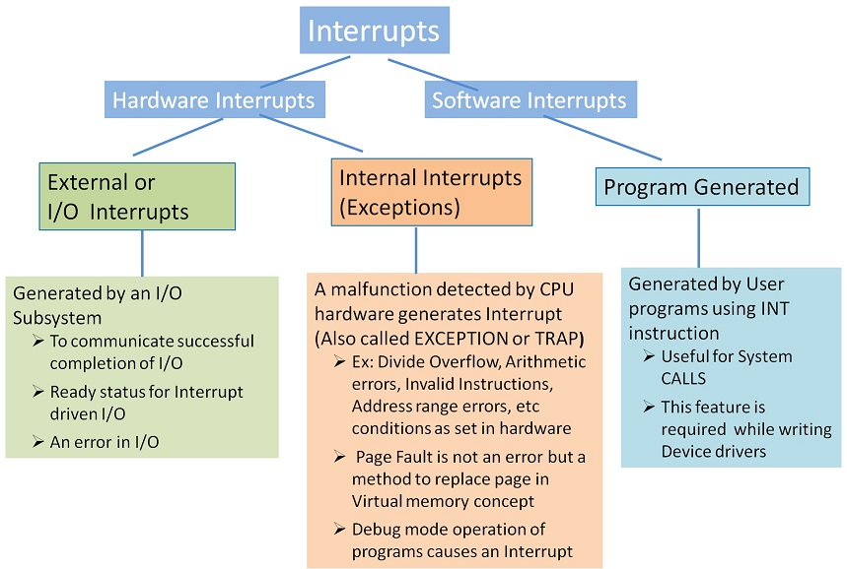
Software interrupts and exceptions.
Interrupt: When a Process is executed by the CPU and when a user Request for another Process then this will create disturbance for the Running Process. This is also called as the Interrupt.

Slide 27
Exceptions
The term exception is used to refer to any event that causes an interruption.Hence, I/O interrupts are one example of an exception.
Recovery from errors – These are techniques to ensure that all hardware components are operating properly.
Ex:Error in the data stored.
Error during the execution of instruction.
Debugging – find errors in a program, trace and breakpoints (only at specific points selected by the user).
Trace: Exception occurs after execution of every instruction.
Breakpoint: Exception occurs only at specific points selected by the user.
Privilege exception – execute privileged instructions to protect OS of a computer.

Slide 28
The exception modes have full access to system resources and can change modes freely. These are entered when specific exceptions occur. Various exceptions occur in the exception modes are as follows:
■ Supervisor mode: Usually what the OS runs in. It is entered when the processor encounters a software interrupt instruction. Software interrupts are a standard way to invoke operating system services on ARM.
■ Abort mode: Entered in response to memory faults.
■ Undefined mode: Entered when the processor attempts to execute an instruction that is supported neither by the main integer core nor by one of the coprocessors.
■ Fast interrupt mode: Entered whenever the processor receives an interrupt signal from the designated fast interrupt source. A fast interrupt cannot be interrupted, but a fast interrupt may interrupt a normal interrupt.
■ Interrupt mode: Entered whenever the processor receives an interrupt signal from any other interrupt source (other than fast interrupt). An interrupt may only be interrupted by a fast interrupt.
When an exception is occurred, then the exception should be handled by the processor. For example, the Nios II processor performs the following actions when an exception is occurred:
Saves the existing processor status information by copying the contents of the status register (ctl0) into the estatus register (ctl1).
Clears the U bit in the status register, to ensure that the processor is in the Supervisor mode.
Clears the PIE bit in the status register, which prevents further external processor interrupts.
Writes the return address, which is the address of the instruction after the exception into the ea register (r29).
Transfers execution to the address of the exception handler, which determines the cause of the exception and calls the required exception-service routine to respond to the exception

Slide 29
Programs and processes – role of interrupts in process state transitions:
A program is a set of instruction codes that has been designed to complete a certain task. It is a passive entity stored in the secondary memory of the computer system. A program is considered as a passive and static entity.
A program is like a file which contains a set of instruction codes stored on a disk in the form of an executable file. A program contains instructions written in any programming language. Programs have an unlimited span of time.
A process is an instance of a program that is being currently executed. It is a dynamic and active entity of a program. Processes are created when the programs are executing and they reside in the main memory.
A process exists only for a limited time, and hence gets terminated as soon as the task completes. A process always consists of instructions written in machine language. A process contains temporary data, data selection, etc.

Slide 30
Difference between Program and Process
Program | Process
It is a set of instructions that has been designed to complete a certain task. | It is an instance of a program that is being currently executed.
It is a passive entity. | It is an active entity.
It resides in the secondary memory of the system. | It is created when a program is in execution and is being loaded into the main memory.
It exists in a single place and continues to exist until it has been explicitly deleted. | It exists for a limited amount of time and it gets terminated once the task has been completed.
It is considered as a static entity. | It is considered as a dynamic entity.
It doesn't have a resource requirement. | It has a high resource requirement.
It requires memory space to store instructions. | It requires resources such as CPU, memory address, I/O during its working.
It doesn't have a control block. | It has its own control block, which is known as Process Control Block.

Slide 31
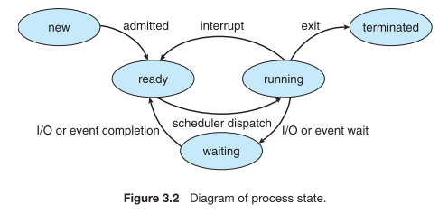

Slide 32
A program which is under execution, together with any information that describes its current state of execution, is called a process. A process can be in one of five states: New, Ready, Running, Waiting and Terminated. As a process executes, it changes state. The state of a process is defined in part by the current activity of that process.
New: The process is being created.
Running: Instructions are currently being executed.
Waiting: The process is waiting for some event to occur (For example, it may be waiting for completion of an I/O operation that it requested earlier).
Ready: The process is waiting to be assigned to a processor.
Terminated: The process has finished execution

Slide 33
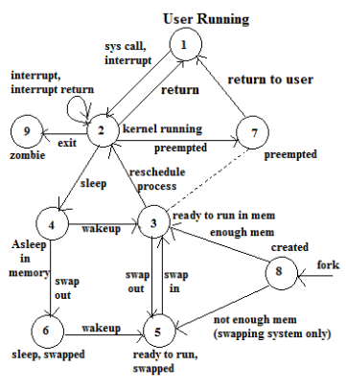
process state transitions Diagram

Slide 34
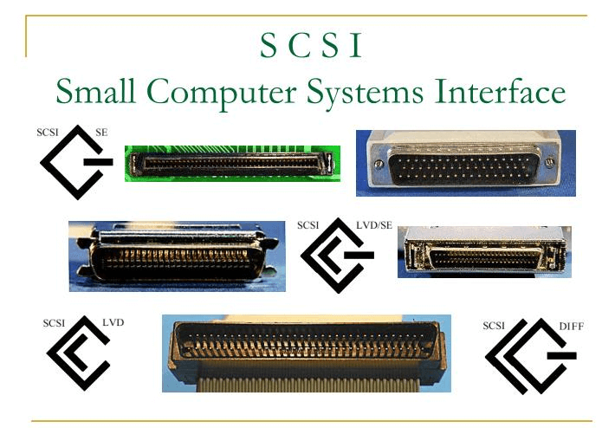
I/O device interfaces – SCSI, USB
SCSI
The Small Computer System Interface (SCSI) is a set of parallel interface standards developed by the American National Standards Institute (ANSI) for attaching printers, disk drives, scanners, modems to small and medium sized and other peripherals to computers.

Slide 35
SCSI generally it can connect up to 16 peripheral devices using a single bus including one host adapter.
SCSI bus was first introduced was commonly used in servers and workstations.
The Small Computer System Interface (SCSI) bus is another type of computer bus that is used to connect hardware devices to a computer.
The SCSI bus was first introduced in the 1980s and was commonly used in servers and workstations.
Today, the SCSI bus is still in use in some enterprise-level applications, but it has largely been replaced by newer technologies.
The SCSI bus is a high-speed, parallel bus that supports multiple devices on the same bus. Each device on the SCSI bus has a unique identification number, known as a SCSI ID, which is used to identify the device and its associated drivers.
The SCSI bus supports a wide range of devices, including hard drives, tape drives, CD/DVD drives, and scanners.
The SCSI bus also supports a variety of data transfer modes, including asynchronous, synchronous, and fast synchronous.

Slide 36
The processor sends a command to the SCSI controller, which causes the following sequence of events to take place:
The SCSI controller contends for control of the bus (initiator).
When the initiator wins the arbitration process, it selects the target controller and hands over control of the bus to it.
The target starts an output operation. The initiator sends a command specifying the required read operation.
The target sends a message to the initiator indicating that it will temporarily suspends the connection between them. Then it releases the bus.
The acronym SCSI stands for Small Computer System Interface. It refers to a standard bus defined by the American National Standards Institute (ANSI) under the designation X3.131 .
In the original specifications of the standard, devices such as disks
are connected to a computer via a 50-wire cable, which can be up to 25 meters in length and can transfer data at rates up to 5 megabytes/s.
The SCSI bus standard has undergone many revisions, and its data transfer capability has increased very rapidly, almost doubling every two years. SCSI-2 and SCSI-3 have been defined, and each has several options.
A SCSI bus may have eight data lines, in which case it is called a narrow bus and transfers data one byte at a time.

Slide 37
Alternatively, a wide SCSI bus has 16 data lines and transfers data 16 bits at a time.
There are also several options for the electrical signaling scheme used.
Devices connected to the SCSI bus are not part of the address space of the processor in the same way as devices connected to the processor bus.
The SCSI bus is connected to the processor bus through a SCSI controller. This controller uses DMA to transfer data packets from the main memory to the device, or vice versa.
A packet may contain a block of data, commands from the processor to the device, or status information about the device.
Communication with a disk drive differs substantially from communication with the main memory.
A controller connected to a SCSI bus is one of two types – an initiator or a target.
An initiator has the ability to select a particular target and to send commands specifying the operations to be performed.
Clearly, the controller on the processor side, such as the SCSI controller, must be able to operate as an initiator.
The disk controller operates as a target. It carries out the commands it receives from the initiator.
The initiator establishes a logical connection with the intended target. Once this connection has been established, it can be suspended and restored as needed to transfer commands and bursts of data.
While a particular connection is suspended, other device can use the bus to transfer information.

Slide 38
This ability to overlap data transfer requests is one of the key features of the SCSI bus that leads to its high performance.
Data transfers on the SCSI bus are always controlled by the target controller. To send a command to a target, an initiator requests control of the bus and, after winning arbitration, selects the controller it wants to communicate with and hands control of the bus over to it.
Then the controller starts a data transfer operation to receive a command from the initiator.
The processor sends a command to the SCSI controller, which causes the following sequence of event to take place:
The SCSI controller, acting as an initiator, contends for control of the bus.
When the initiator wins the arbitration process, it selects the target controller and hands over control of the bus to it.
The target starts an output operation (from initiator to target); in response to this, the initiator sends a command specifying the required read operation.

Slide 39
USB(Universal Serial Bus)
The Universal Serial Bus (USB) bus is a newer type of computer bus that is widely used to connect hardware devices to a computer.
The USB bus was first introduced in the late 1990s and has since become one of the most widely used bus technologies.
The USB bus is a serial bus that supports multiple devices on the same bus.
Each device on the USB bus has a unique identification number, known as a USB ID, which is used to identify the device and its associated drivers.
The USB bus supports a wide range of devices, including keyboards, mice, printers, scanners, cameras, and storage devices such as external hard drives and flash drives.
The USB bus also supports a variety of data transfer modes, including low-speed, full-speed, and high-speed. In addition, the USB bus provides power to connected devices, which eliminates the need for separate power supplies.

Slide 40
USB Architecture

Slide 41
The USB uses point-to-point connections and a serial transmission format. When multiple devices are connected, they are arranged in a tree structure.
Each node of the tree has a device called a hub, which acts as an intermediate transfer point between the host computer and the I/O devices. At the root of the tree, a root hub connects the entire tree to the host computer.
The leaves of the tree are the I/O devices: a mouse, a keyboard, a printer, an Internet connection, a camera, or a speaker. The tree structure makes it possible to connect many devices using simple point-to-point serial links.
When a device is first connected to a hub, or when it is powered on, it has the address 0 (7-btt address). Periodically, the host polls each hub to collect status information and learn about new devices that may have been added or disconnected.
When the host is informed that a new device has been connected, it reads the information in a special memory in the device’s USB interface to learn about the device’s capabilities. It then assigns the device a unique USB address and writes that address in one of the device’s interface registers. It is this initial connection procedure that gives the USB its plug-and-play capability.

